Slide 1
Topic 17: Electric Field
17.1 Concept of an electric field
17.2 Uniform electric fields
17.3 Force between point charges
17.4 Electric field of a point charge
17.5 Electric potential

Slide 2
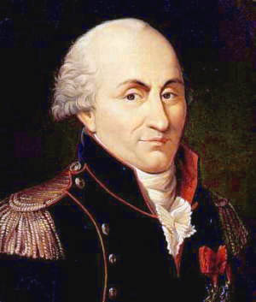
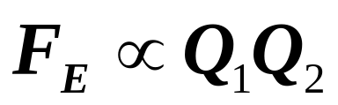
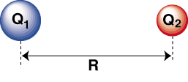
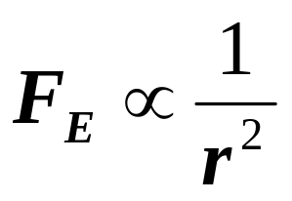
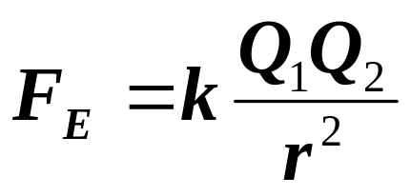
Coulomb’s Law
The electrostatic force of interaction between two charged particles is proportional to the product of their charges and inversely proportional to the square of their separation and its direction is along the line joining the two charges.
Charles Coulomb 1736-1806
r
+

Slide 3
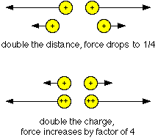
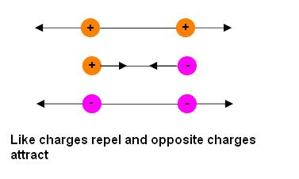
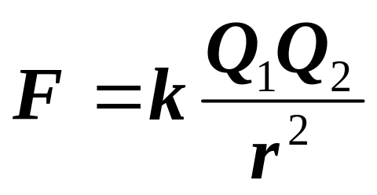
Coulomb’s Law
Inversely proportional to r²
Directly proportional to Q₁Q₂
Charles Coulomb 1736-1806
Direction of Force

Slide 4
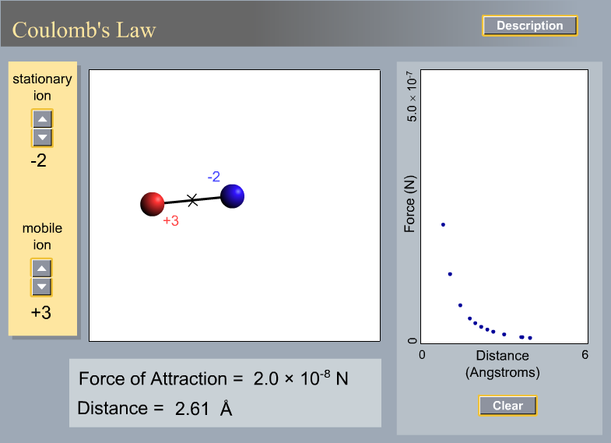
Coulomb’s Law: Graph

Slide 5
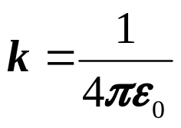
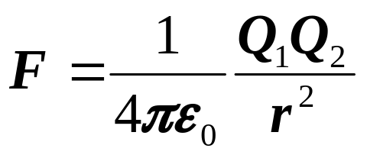
Coulomb’s Law
Calculate the value of k [k = 1/(4πε₀)]
ε₀ = permittivity of free space
= 8.85 × 10⁻¹² C²m⁻²N⁻¹ or Fm⁻¹
Permittivity is the ability of a material to transmit (or permit) an electric field.
k = 9 × 10⁹ Nm²C⁻²

Slide 6
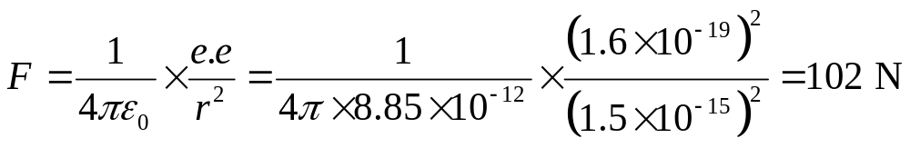
Example 1
  By assuming that a hydrogen atom consists of an electron of charge e⁻ orbiting a proton of charge e⁺, calculate the force between the electron and proton if the diameter of hydrogen atom is 3 × 10⁻¹⁵ m.
  (e = 1.6 × 10⁻¹⁹ C, ε₀ = 8.85 × 10⁻¹² Fm⁻¹)
  Solution:

Slide 7
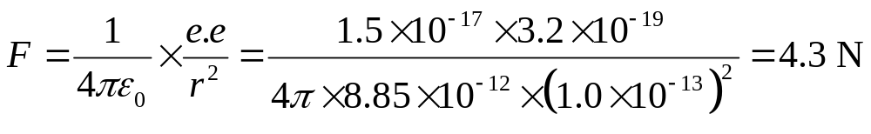
Example 2
  The charge on the uranium nucleus is 1.5 × 10⁻¹⁷ C and the charge on the α-particles is 3.2 × 10⁻¹⁹ C. What is the electrostatic force between a uranium nucleus and an α-particle separated by 1.0 × 10⁻¹³m?
  (Take ε₀ = 8.85 × 10⁻¹² Fm⁻¹)
  Solution:

Slide 8
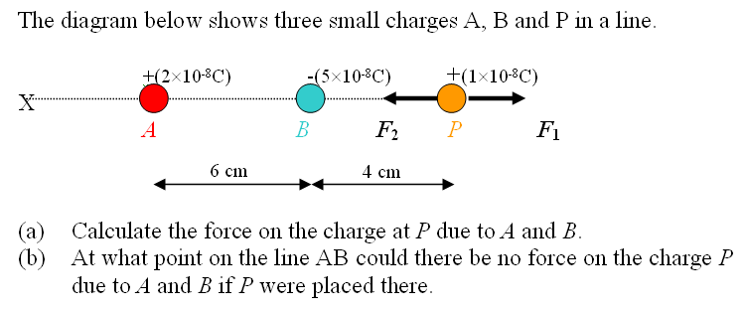
Example
(Take k = 9.0 × 10⁹ Nm²C⁻²)

Slide 9
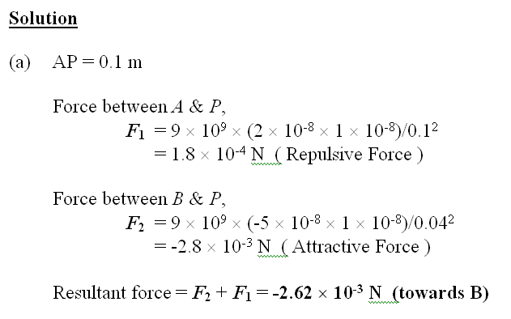
Solution

Slide 10
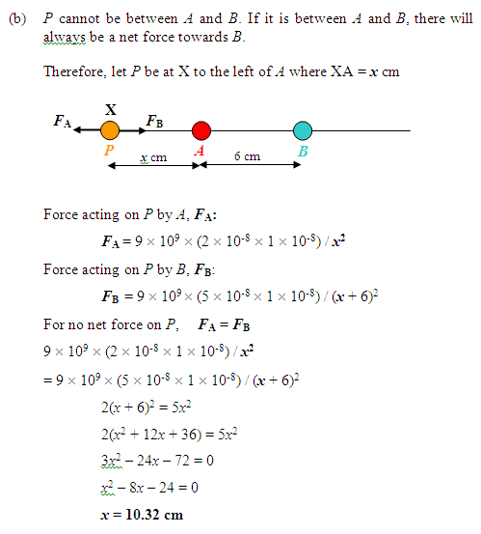
Solution

Slide 11
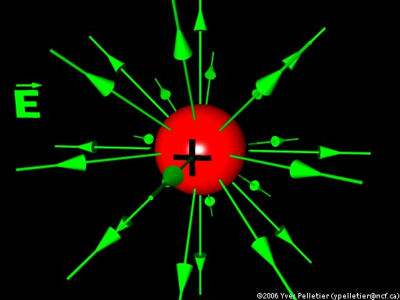
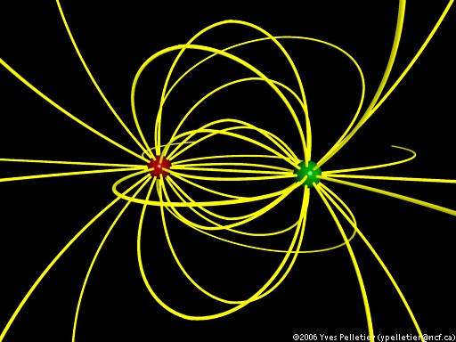
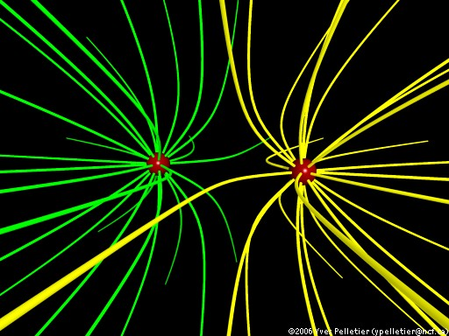
Electric Field
An electric field is a region where a force acts on a charged body placed in the region.
Electric field created by two oppositely charged particles.
Electric field created by two same-charge particles.
Electric field created by a positively charged particle.

Slide 12
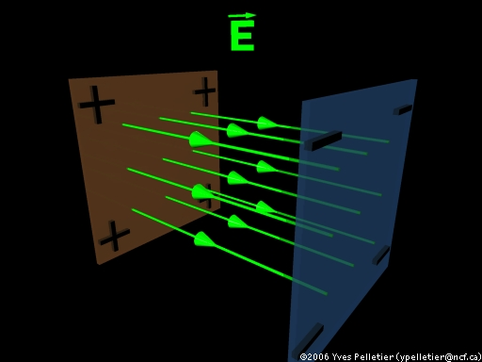
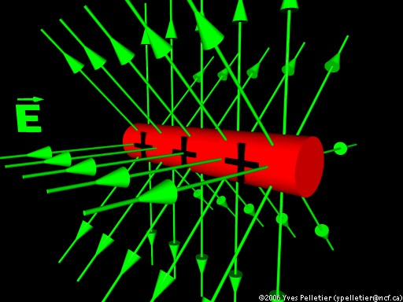
Electric Field
An electric field is a region where a force acts on a charged body placed in the region.
Electric field created by a charged cylinder.
Electric field created by two oppositely charged plates.

Slide 13
Electric Field
An electric field can be represented by lines of force.
The lines of force in an electric field show the paths along which a charged particles would move in the field.
The direction shown on a line of force is the direction along which a free positive test charge would move.

Slide 14
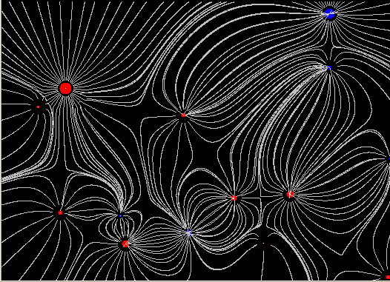
Electric Field
Multiple Charges
Where lines are close together, it denotes a strong field.

Slide 15
Electric Field Strength, E
To each point in an electric field is associated a quantity known as the electric field intensity or electric field strength E
Definition: The electric field strength E at a point in an electric field is the force acting on unit positive test charge placed at that point.

Slide 16
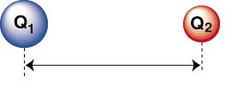

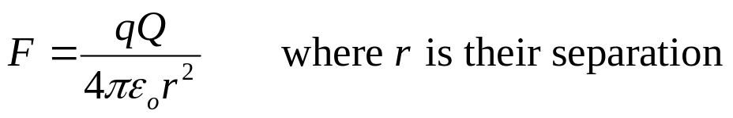
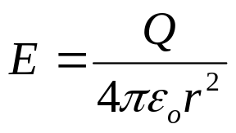
Electric Field Strength E
Q
q
r
Using Coulomb’s Law, consider a positive test charge q near a much larger point charge Q. The force on the test charge is given by:
Unit of E is N C⁻¹
The electric field strength E at that point is defined as force per unit positive charge, F / q.
Hence:
where E = Electric field strength
r = Distance from point charge Q

Slide 17
Example
Find the electric field strength 50 cm from a positive point charge of 1 × 10⁻⁴ C.
(ε₀ = 8.85 × 10⁻¹² Fm⁻¹)
Solution
E = Q /(4πε₀r²)
= 1 × 10⁻⁴ / (4π × 8.85 × 10⁻¹² × 0.50²)
= 3.60 × 10⁶ N C⁻¹

Slide 18
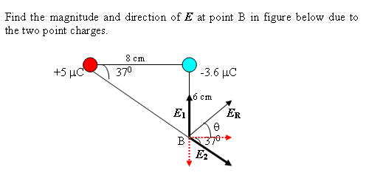
Example

Slide 19
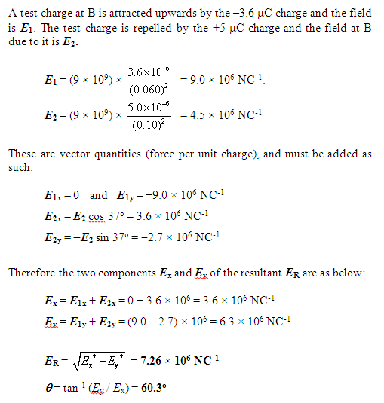
Solution

Slide 20
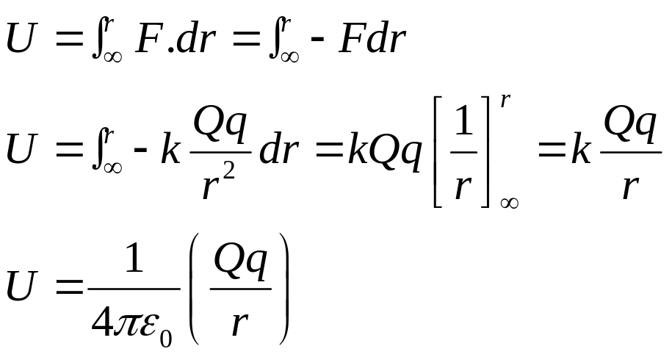
Electric Potential Energy
F
dr
∞
+Q
+q
r
The electric potential energy U of a positive spherical charge +q at a particular point is defined as the work done on the charge in moving it from infinity to that point.
U = Work done

Slide 21
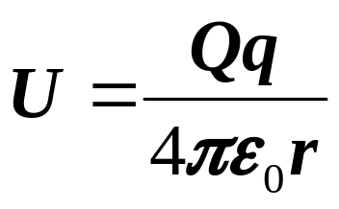
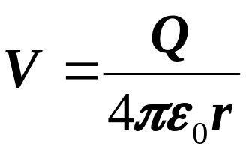
Electric Potential
F
dr
∞
+Q
1C
r
The electric potential V of a point in an electric field is defined as the work done in bringing unit positive charge from infinity to that point.
V = W / q = U / q
Unit of Potential
= JC⁻¹
= V (volt)

Slide 22
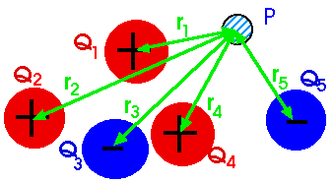
Electric Potential
Since potential is a scalar quantity, the electric potential at a point P due to multiple point charges are the scalar sum of individual potentials.
V_{A} = V₁ + V₂ + V₃ + ... + V_{n}

Slide 23
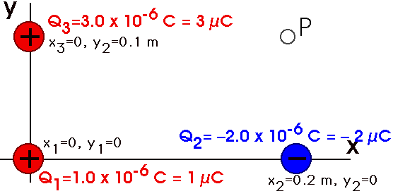
Example
What is the potential at P?

Slide 24
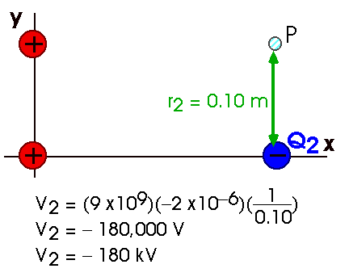
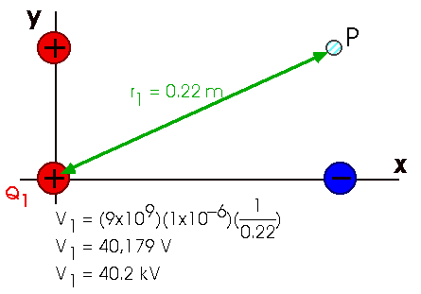
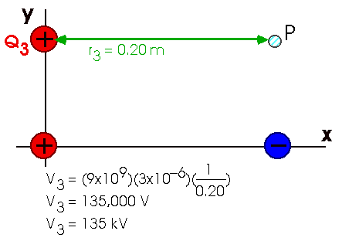
Solution
        V_{p} = V₁ + V₂ + V₃
        = 40.2 – 180 + 135
        = - 4.8 kV

Slide 25
Electric Potential Difference
A
B
+Q
1C
1C
r_{A}
r_{B}
The electric potential difference V_{AB} between two points in an electric field is the work done in taking one coulomb of positive charge from A to B.
W_{AB} = qV_{AB}
Taking a charge from a point of lower potential to one of higher potential results in the charge gaining in potential energy. The reverse movement from a position of higher potential to one of lower potential is analogous to a free falling object under gravity where the object loses potential energy and gains in kinetic energy.

Slide 26
Example
Two positive point charges, of 12 μC and 8 μC respectively, are 10 cm apart. Find the work done in bringing them 4 cm closer so they are 6 cm apart. What is the work done if both charges are negative? What if one is positive and the other negative? (Assume 1/(4πε₀) = 9 x 10⁹ m/F)
Solution
At a separation of 10 cm, the initial P.E. is
U_{i} = (qQ)/(4πε₀r_{i}) = (12 x 10⁻⁶ x 8 x 10⁻⁶) x (9 x 10⁹) / 0.1
= 8.6 J
At a separation of 6 cm, the final P.E. is
U_{f}= (qQ)/(4πε₀r_{f}) = (12 x 10⁻⁶ x 8 x 10⁻⁶) x (9 x 10⁹) / 0.06
= 14.4 J
∴ From Principle of Conservation of Energy,
ΔU = U_{f} − U_{i} = 14.4 − 8.6 = 5.8 J
If both charges are negative, ΔU = 5.8 J
If the two charges are opposite in sign, ΔU = (-14.4) − (-8.6) = - 5.8J
Opposite charges lose potential energy when brought closer together

Slide 27
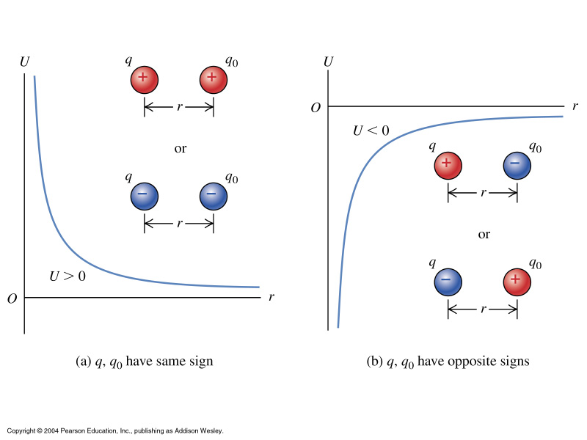
Graphs of the potential energy U of two point charges q and q₀ versus their separation r.

Slide 28
Relation between V and E
+Q
-F
+q
+q
F
Δr
Consider a positive test charge q placed near a positive point charge Q. To move q towards Q by a small displacement Δr, work ΔW must be expended.
ΔW = -F Δr
ΔW / q = - (F / q) Δr
ΔV = - E Δr
Therefore, E = - ΔV / Δr or E = - dV / dr
dV / dr is known as the potential gradient. It can be obtained from the slope of a V-r graph.
The negative sign indicates that the electric field is increasing in the opposite direction to r when the potential increases in the direction of r.

Slide 29
Potential Gradient
Potential and electric field intensity E = - dV/dr
Potential (V)
High field intensity
Low field intensity
16
8
4
2
2
4
8
16
Distance (x)

Slide 30
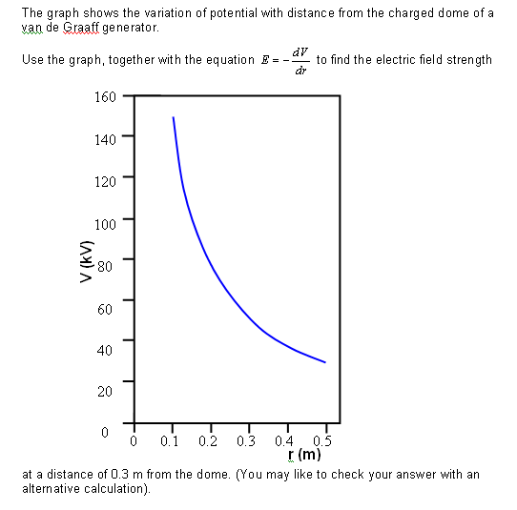
Example
The field strength will be the negative of the gradient at r = 0.3m.
This should give a value of around 1.7 x 10⁵ N C⁻¹.

Slide 31
Solution
The field strength will be the negative of the gradient at r = 0.3 m. This should give a value of around 1.7 x 10⁵ N C⁻¹.
Alternative Calculation:
To calculate this we note that at 0.3 m the potential is 50 kV.
V = k Q/r and E = k Q/r²
Therefore, E = V/r,
E = 50 000 / 0.3 = 1.7 x 10⁵ N C⁻¹.

Slide 32
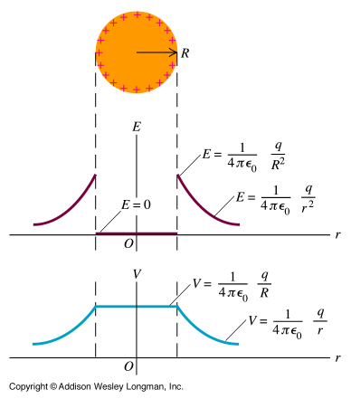
Electric field E and potential V at points inside and outside a positively
charged
spherical conductor.

Slide 33
Gravitational & Electric Field
List out the similarities and differences between the gravitational field and the electric field.

Slide 34
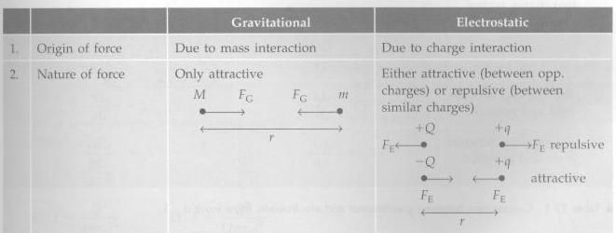
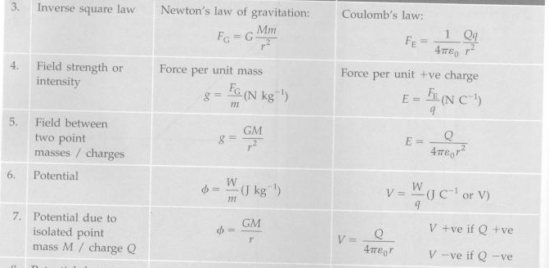

Slide 35
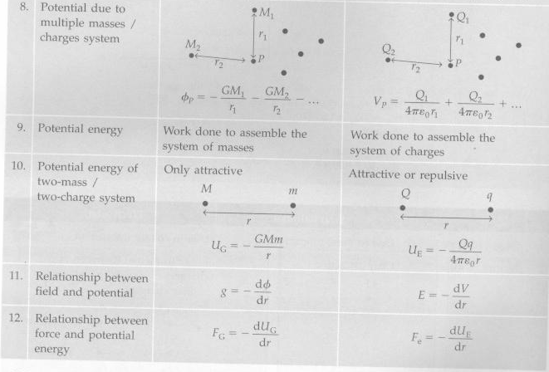

Slide 36
The End

